Slide 1

Today’s Agenda
Design of seuquencial circuit using JK and T- flip flops

Slide 2
F/F Excitation Table (JK)
Characteristic Table
Excitation Table
Present State | Next State | F.F. Input
Q(t) | Q(t+1) | J | K
0 | 0
0 | 1
1 | 0
1 | 1
J | K | Q(t+1)
0 | 0 | Q(t)
0 | 1 | 0
1 | 0 | 1
1 | 1 | Q’(t)
No change
Reset
Set
Toggle
0 0 (No change)
0 1 (Reset)
0 x
1 x
x 1
x 0
1 0 (Set)
1 1 (Toggle)
0 1 (Reset)
1 1 (Toggle)
0 0 (No change)
1 0 (Set)
Q(t+1) = 0 Kab kab?
J =0, K = 1
J =0, K = 0 (because Q(t+1) = Q(t) = 0)

Slide 3
3 (or more) Consecutive 1’s Detector ̶ Using JK
Present State |  | Input | Next State |  | Flip-Flop Inputs
A | B | x | A | B | J_{A} | K_{A} | J_{B} | K_{B}
0 | 0 | 0 | 0 | 0
0 | 0 | 1 | 0 | 1
0 | 1 | 0 | 0 | 0
0 | 1 | 1 | 1 | 0
1 | 0 | 0 | 0 | 0
1 | 0 | 1 | 1 | 1
1 | 1 | 0 | 0 | 0
1 | 1 | 1 | 1 | 1
Synthesis using JK F.F.
0 x
0 x
0 x
1 x
x 1
x 0
x 1
x 0
0 x
1 x
x 1
x 1
0 x
1 x
x 1
x 0
J_{A} (A, B, x) = ∑ (3)
d_{JA} (A, B, x) = ∑ (4,5,6,7)
K_{A} (A, B, x) = ∑ (4, 6)
d_{KA} (A, B, x) = ∑ (0,1,2,3)
J_{B} (A, B, x) = ∑ (1, 5)
d_{JB} (A, B, x) = ∑ (2,3,6,7)
K_{B} (A, B, x) = ∑ (2, 3, 6)
d_{KB} (A, B, x) = ∑ (0,1,4,5)

Slide 4
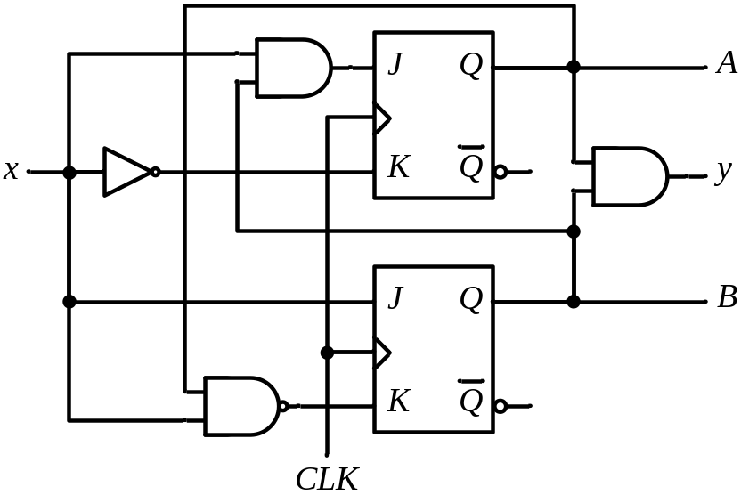
3 (or more) Consecutive 1’s Detector ̶ Using JK
Synthesis using JK Flip-Flops
J_{A} = B x K_{A} = x’
J_{B} = x K_{B} = A’ + x’
 |  |  |  | B
 |  | 0 | 0 | 1 | 0
A |  | x | x | x | x
 |  |  | x
 |  |  |  | B
 |  | x | x | x | x
A |  | 1 | 0 | 0 | 1
 |  |  | x
 |  |  |  | B
 |  | 0 | 1 | x | x
A |  | 0 | 1 | x | x
 |  |  | x
 |  |  |  | B
 |  | x | x | 1 | 1
A |  | x | x | 0 | 1
 |  |  | x

Slide 5
F/F Excitation Table (T)
Characteristic Table
Excitation Table
Q(t) | Q(t+1) | T
0 | 0
0 | 1
1 | 0
1 | 1
T | Q(t+1)
0 | Q(t)
1 | Q’(t)
0
1
1
0
No change
Toggle

Slide 6
3 (or more) Consecutive 1’s Detector ̶ Using T
Present State |  | Input | Next State |  | F.F. Input
A | B | x | A | B | T_{A} T_{B}
0 | 0 | 0 | 0 | 0
0 | 0 | 1 | 0 | 1
0 | 1 | 0 | 0 | 0
0 | 1 | 1 | 1 | 0
1 | 0 | 0 | 0 | 0
1 | 0 | 1 | 1 | 1
1 | 1 | 0 | 0 | 0
1 | 1 | 1 | 1 | 1
Synthesis using T Flip-Flops
0
0
0
1
1
0
1
0
0
1
1
1
0
1
1
0
T_{A} (A, B, x) = ∑ (3, 4, 6)
T_{B} (A, B, x) = ∑ (1, 2, 3, 5, 6)

Slide 7
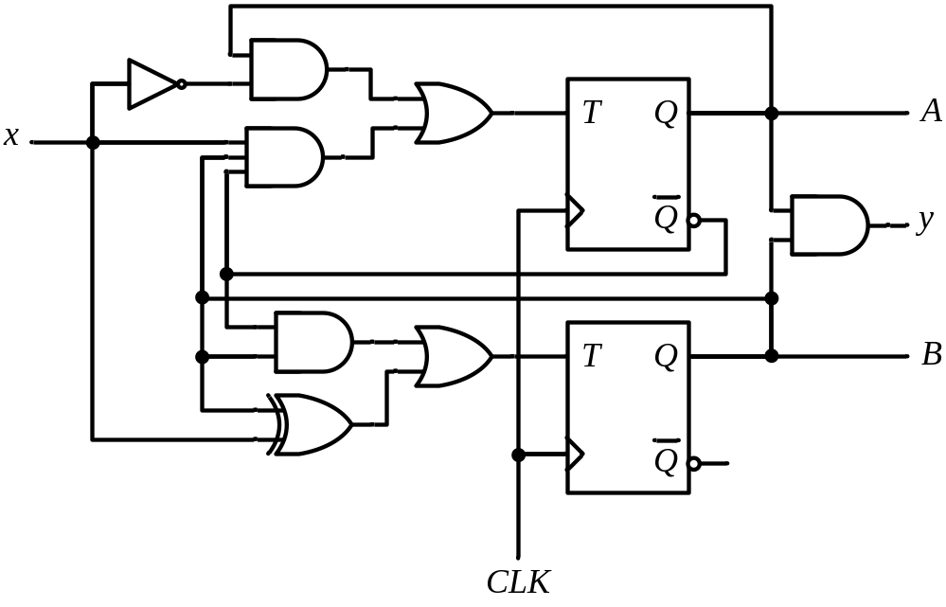
3 (or more) Consecutive 1’s Detector ̶ Using T
Synthesis using T Flip-Flops
T_{A} = A x’ + A’ B x
T_{B} = A’ B + B ⊕ x
 |  |  |  | B
 |  | 0 | 0 | 1 | 0
A |  | 1 | 0 | 0 | 1
 |  |  | x
 |  |  |  | B
 |  | 0 | 1 | 1 | 1
A |  | 0 | 1 | 0 | 1
 |  |  | x

Slide 8
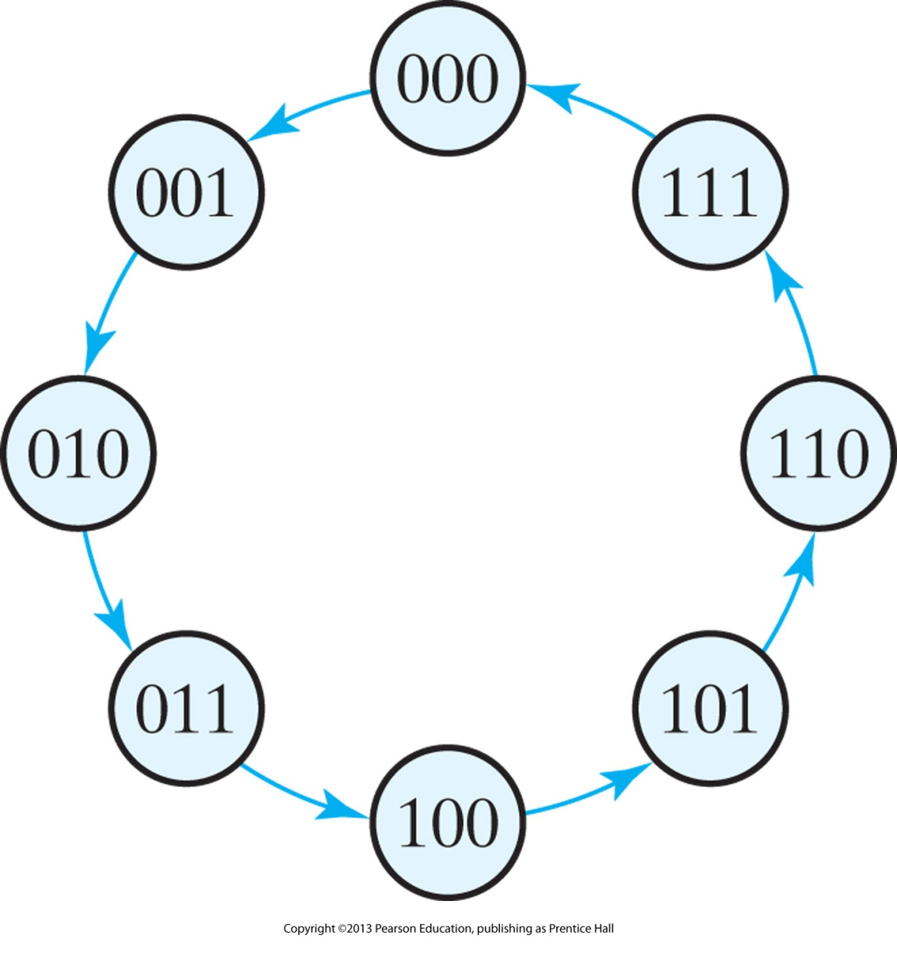
Example 2: 3 Bit Binary Counter Using T F/F

Slide 9
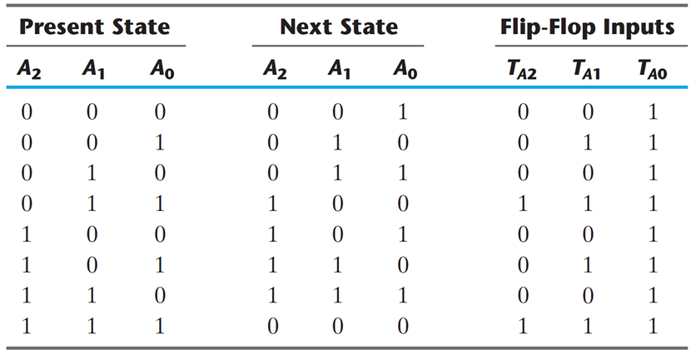
Example 2: 3 Bit Binary Counter Using T F/F

Slide 10
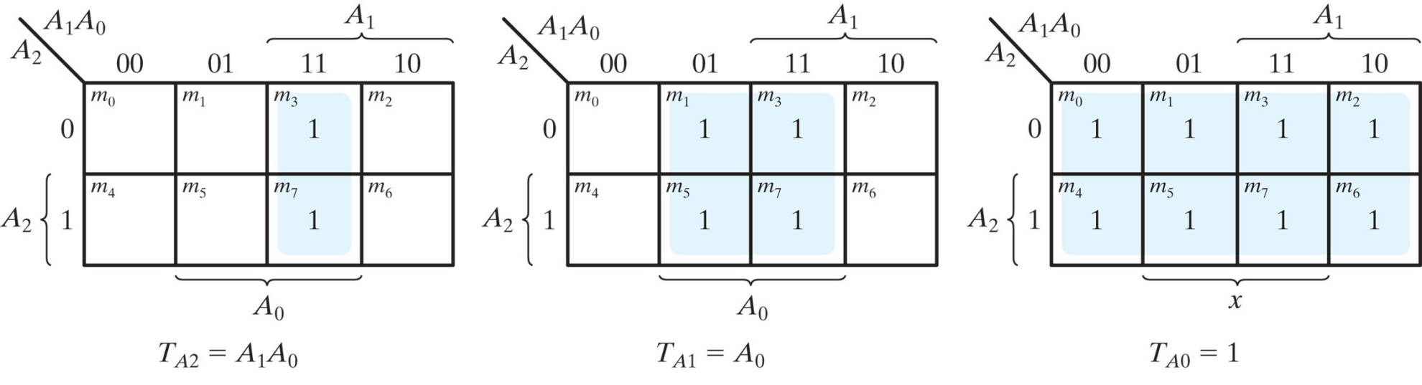
Example 2: 3 Bit Binary Counter Using T F/F

Slide 11
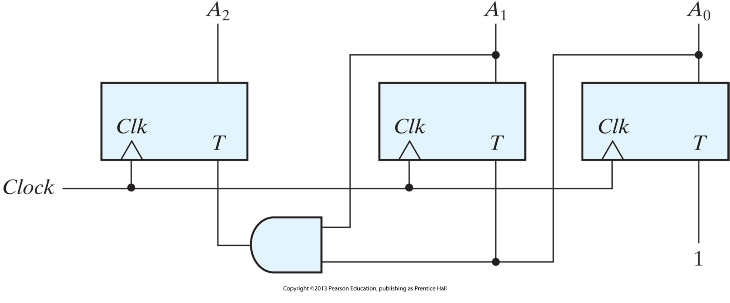
Example 2: 3 Bit Binary Counter Using T F/F

Slide 12
Practice Problems
5.17 to 5.20

